Slide 1







Scratchpads
Publishing biodiversity:
The interplay between Scratchpads
and the
Biodiversity Data Journal
Dr Dimitrios Koureas
Biodiversity Informatics Group
The Natural History Museum London
Notes:
1.

Slide 2
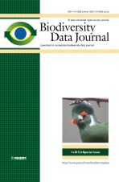

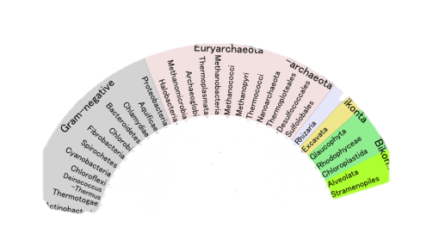
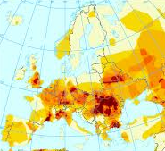
The four nodes of data cycle
a
seamless
workflow
Data
collection &
generation
Data
publishing
Data
curation
Data
analysis
Notes:
So eventually what we need is to eliminate these two bottlenecks in the process. We need a seamless data workflow that will allow to make a better use of all available datasets and also allow researchers to take credit for all their research volume.

Slide 3
We have to:
Incentivise researchers
Enable data mobilisation
Facilitate data flow

Slide 4
The vision
Helping researchers take
credit for all research products

Slide 5


The vision
Publication module

Slide 6
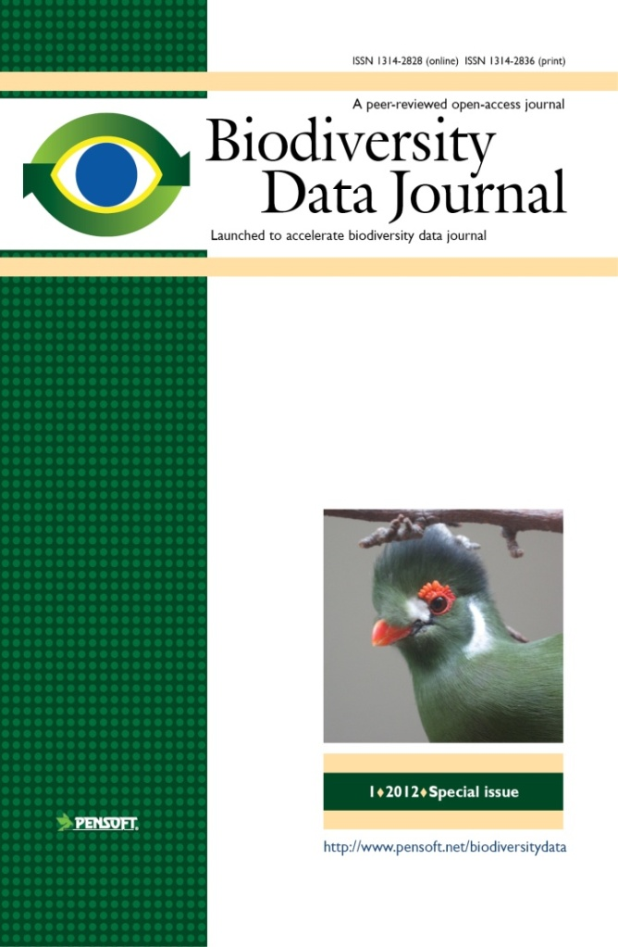
The main features
The
Publication
module
Open-access
journal

Slide 7
What will BDJ publish?
Single taxon treatments and nomenclatural acts
Local or regional checklists
Sampling reports and occasional inventories
Habitat-based checklists and inventories
Ecological and biological observations of species and communities?
Single identification keys
biodiversity-related databases, including genomic, ecological and environmental data (data papers)
Biodiversity-related software tools

Slide 8
How do
Scratchpads
and the
BDJ
interact?

Slide 9
Working in a single environment
Allow submission of
datasets
for publication
without
reformatting and restructuring
based on standardised XML schema

Slide 10
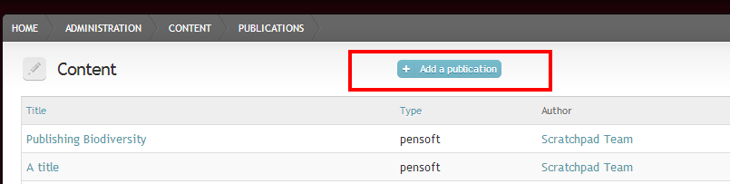
Assembling a manuscript
Work on multiple manuscripts
Allocate different people to different manuscripts
Handle permissions

Slide 11

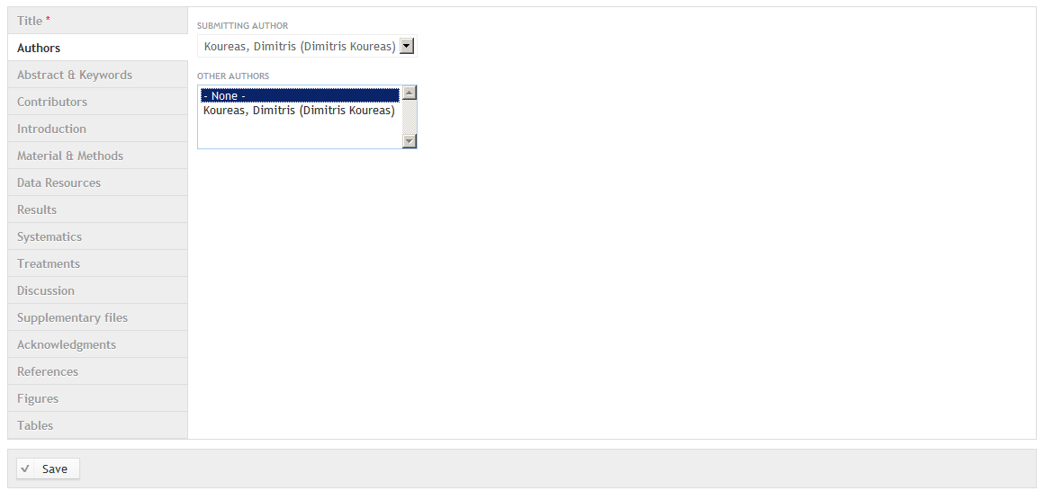
Assembling a manuscript
Data included in manuscript in a structured annotated format
Author names and affiliations
Notes:
No need to restructure, correctly format or gather additional data. Once entered in Scratchpad they can automatically be added to the publication.

Slide 12
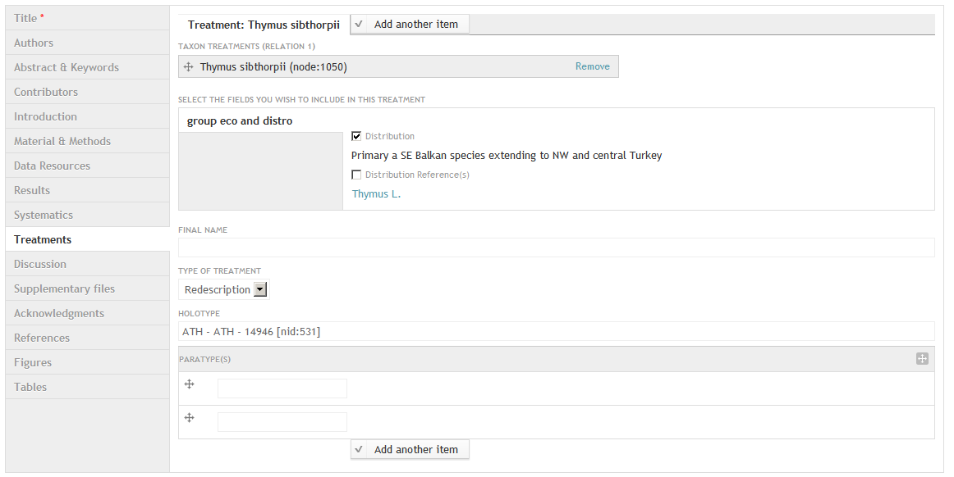
Assembling a manuscript
Taxon descriptions

Slide 13
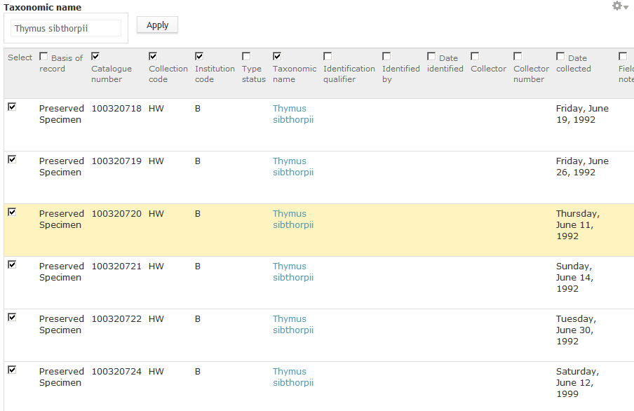
Assembling a manuscript
Specimen data

Slide 14
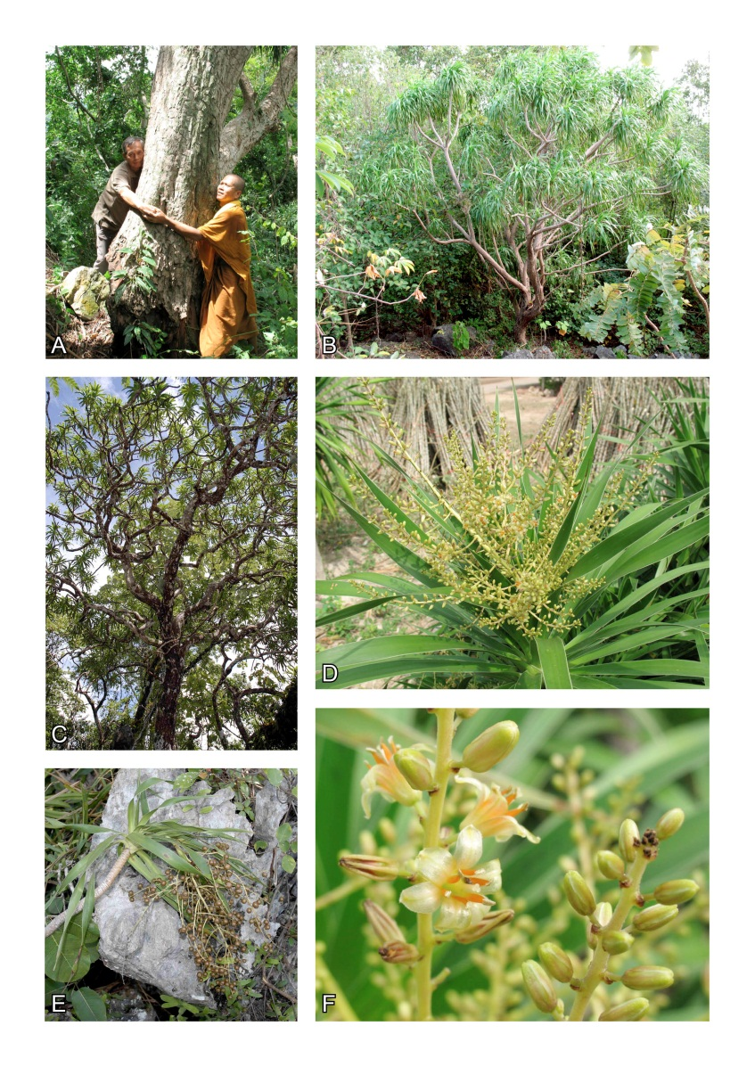
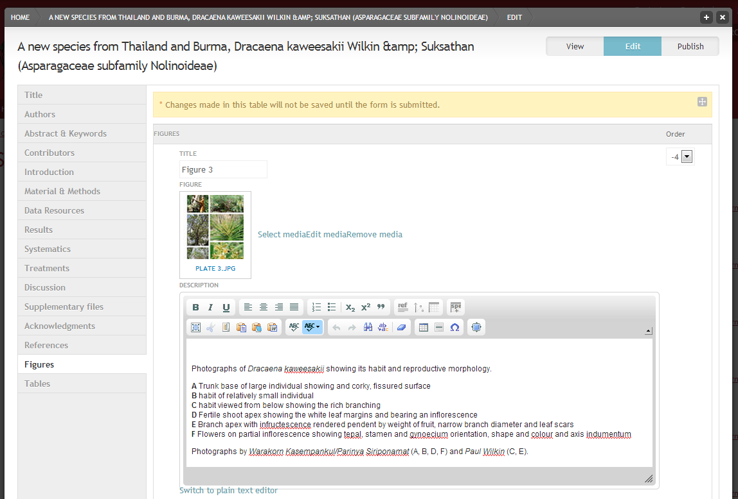
Figures and Tables

Slide 15
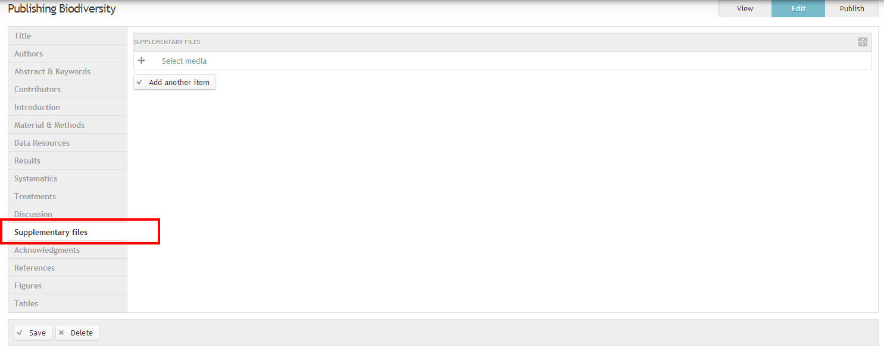
Supplementary files
Select from existing or upload new

Slide 16
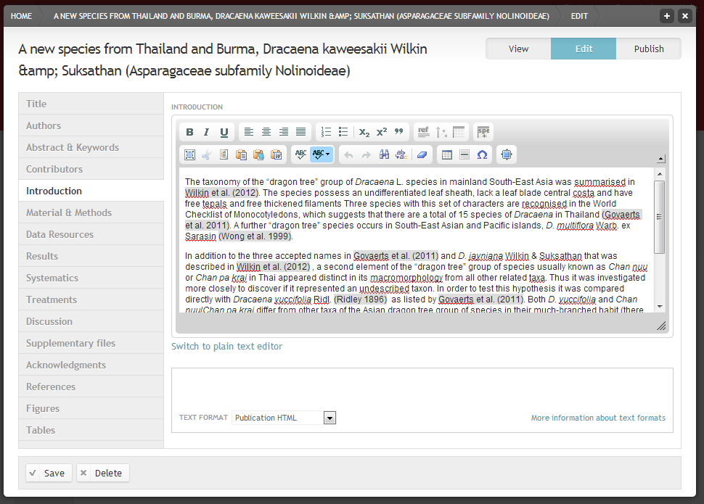
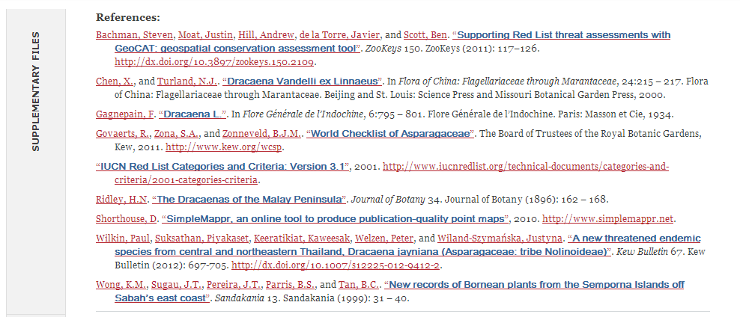
Assembling a manuscript
References
Easily cite bibliography
Auto compile list of references

Slide 17
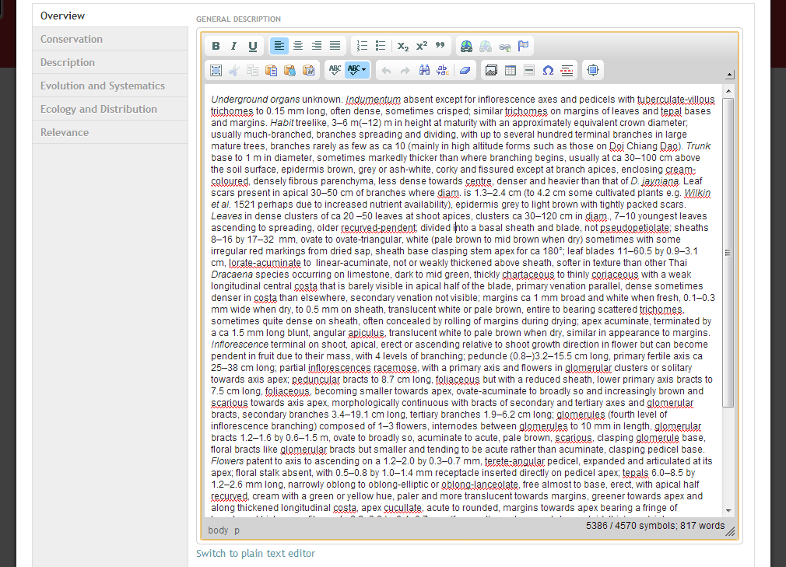
Assembling a manuscript
Texts

Slide 18

The publication module
Author names and affiliations
Taxon descriptions
Specimen data
Figures and Tables
XML
Keys
References
Supplementary files
Texts

Slide 19
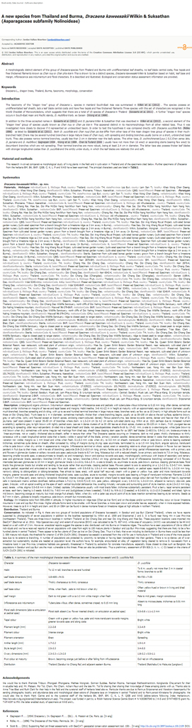
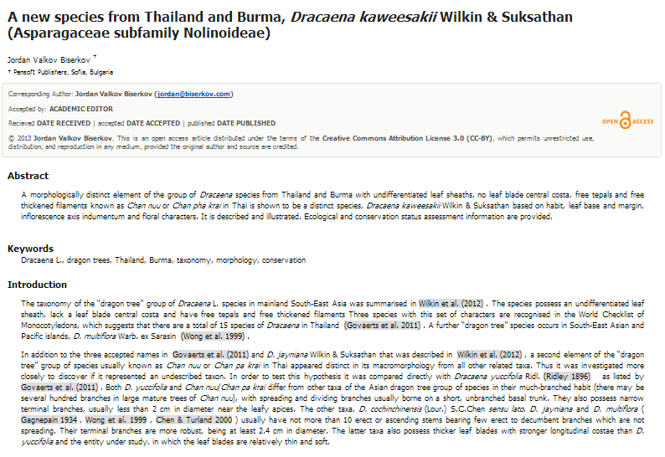
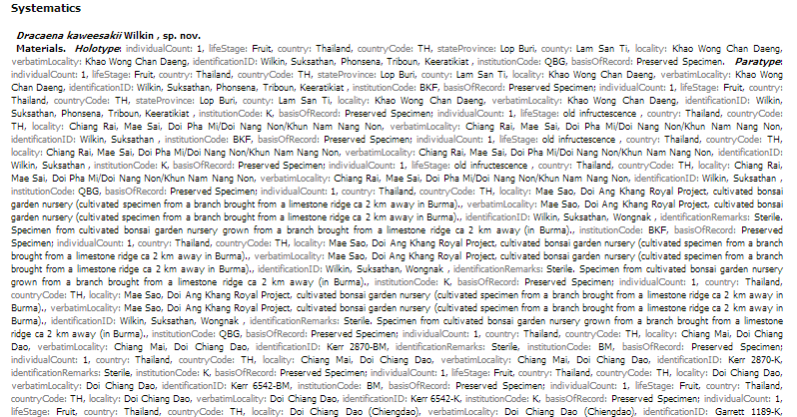
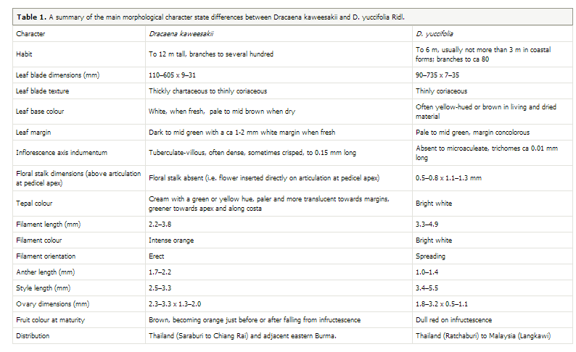
Previewing your manuscript

Slide 20
Submission & enhanced peer review
Manuscript data validation
One-click submission to BDJ
Traditional peer review and optional panel/public review
Notes:
Prior to submission all data are validated to ensure there are no important missing fields.
Once you have finished your manuscript there is a simple one-click submission process where all your specified authors and contributors are given access to the article in the Pensoft Journal System and will be updated on the review process.

Slide 21










The workflow
Scratchpads
XML submission
PENSOFT JOURNAL SYSTEM
(PJS 2.0)
Community
MANUSCRIPT published
(XML, PDF)
Archive
datasets
Occurrence data
Taxon treatments
Taxon names
Plazi
Wiki

Slide 22


Data
collection &
generation
Data
publishing
Data
curation
Thank you
Data
analysis

Slide 23






















Our current taxonomic data production
15-20k new spp. described annually (2M total)¹
30k nomenclatural acts (12M total) ¹
20k phylogenies (750k total)²
31k taxa sequenced (360k taxa total)³
800k BioMed papers (40M total pp. of taxonomy) ⁴
Figures from 1) Zhang, Zootaxa 2011 4, 1-4; 2) Web-of-Science; 3) Genbank and 4) PubMed.
Notes:
Our larger taxonomic community produces more data than ever before. Almost 20k new taxa are described annually. While 30k nomenclatural acts are published. All these usually based on countless specimens, images maps keys and datasets that most of the times remain unpublished. Typically all this taxonomic outcome is generated by small communities during local or regional research projects.

